Slide 1


Fall 2026 MSTU5013 Lab
Week 1: Introduction
Instructor: Iva Li, PhD
CA: Zi Wang

Slide 2
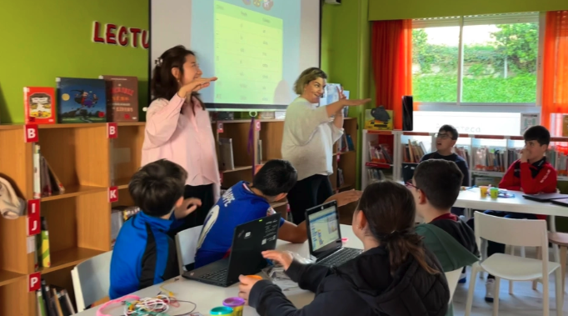
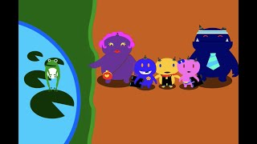

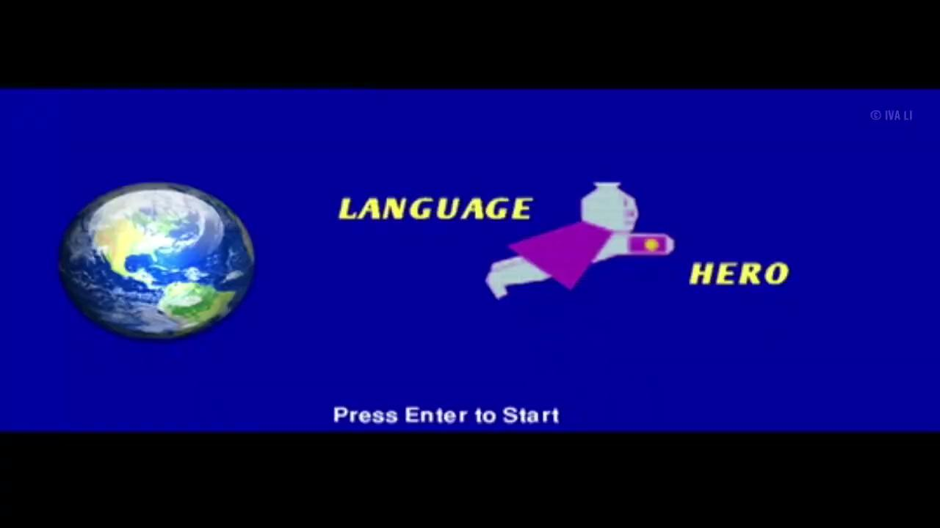
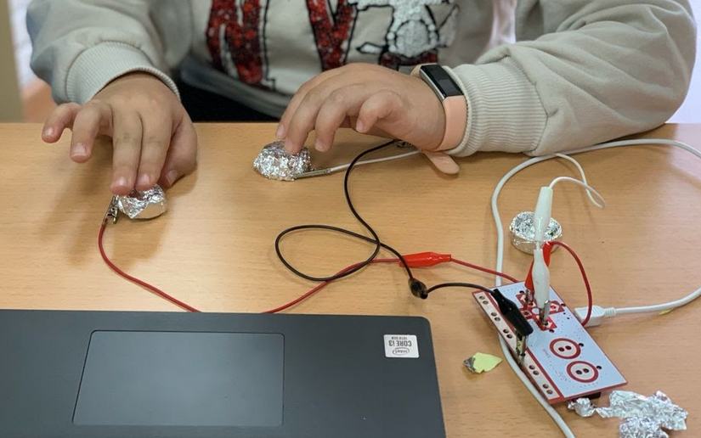
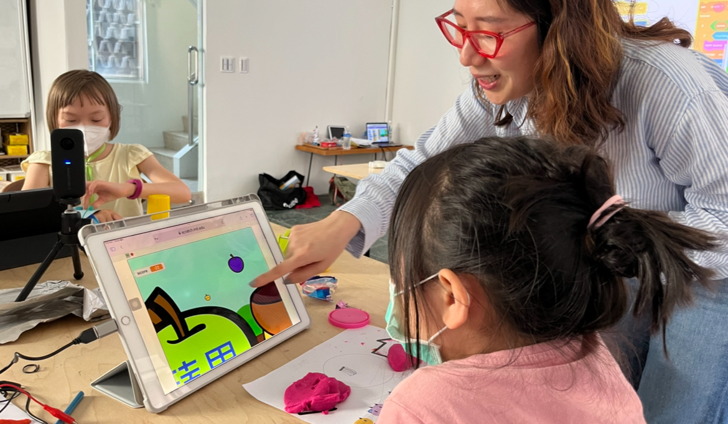

Slide 3
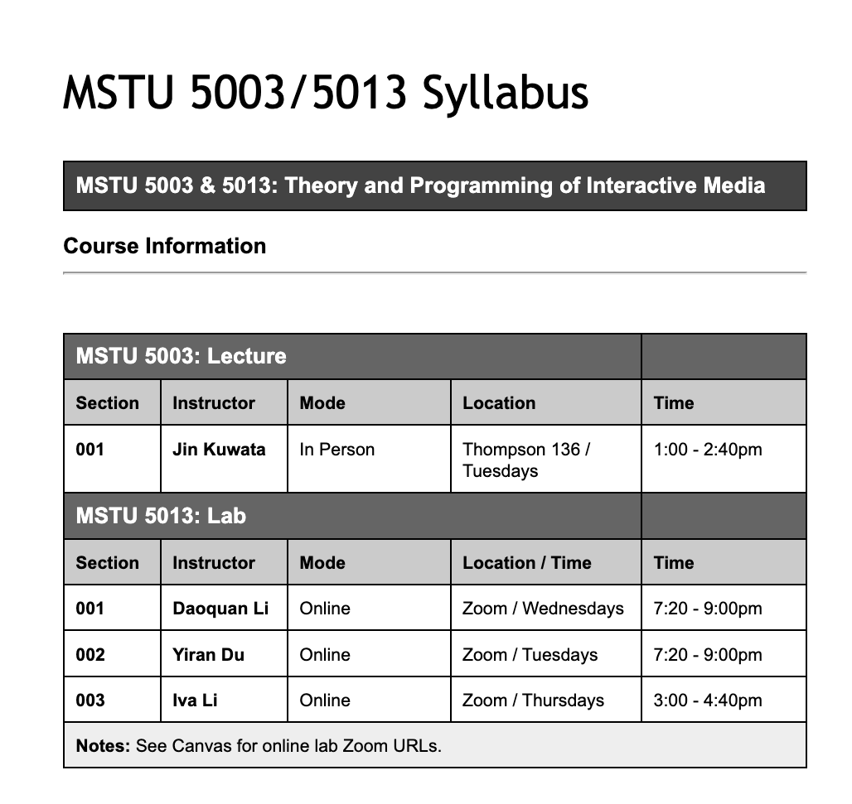
Syllabus Review
Office Hours
Link: https://shorturl.at/m0MKa
Lecture: Fundamental Concepts
Lab: Skills and Support
Iva: Fridays 12-1pm
https://shorturl.at/Dz4ko
Zi: Thursdays 1:30-2:30pm
https://teacherscollege.zoom.us/j/96948438140

Slide 4




Tools

Slide 5
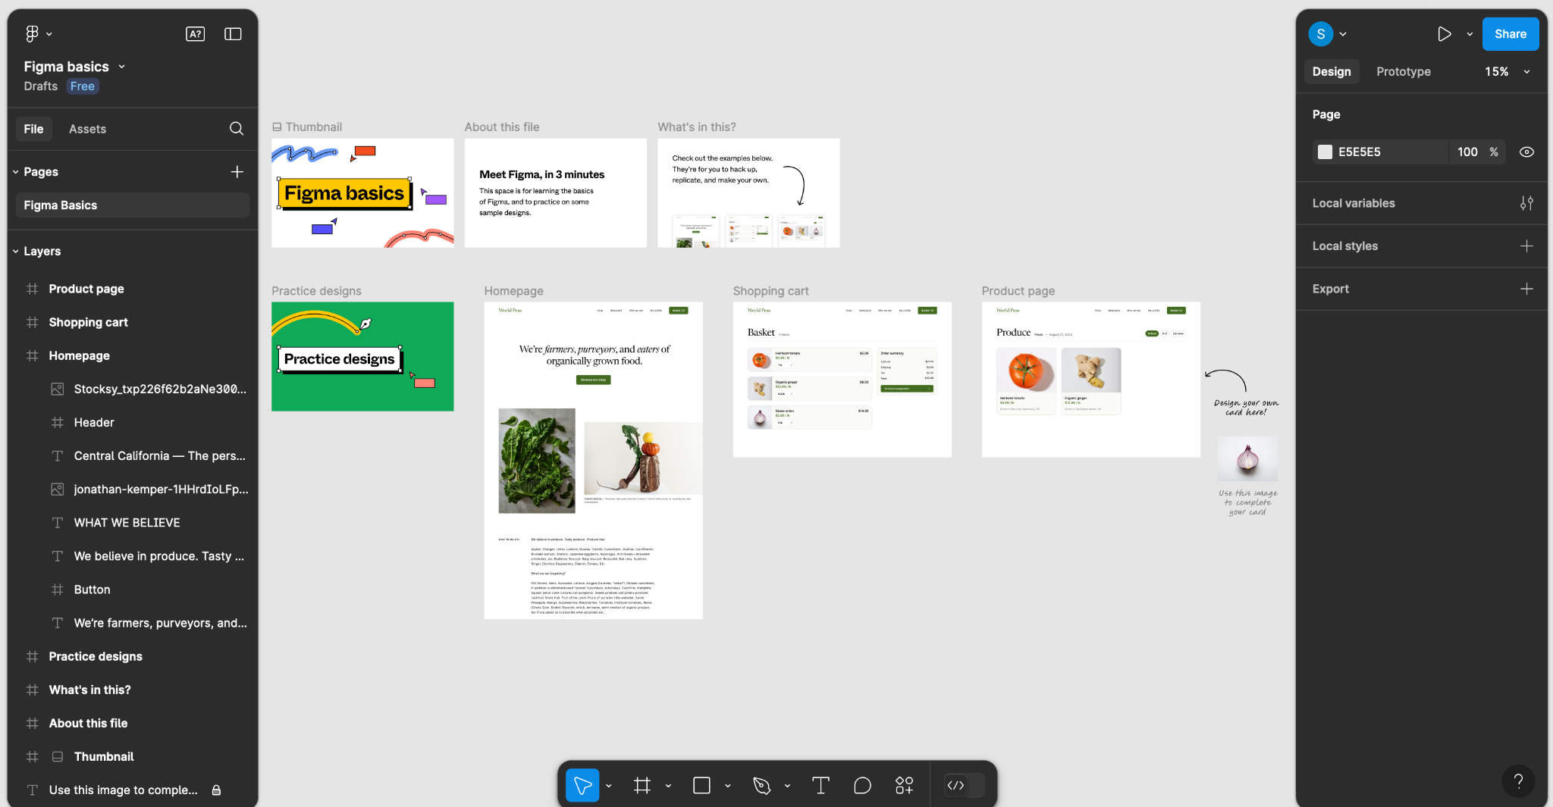
Figma Introduction
Figma is a web based platform that allows you to create, prototype, and collaborate on digital designs.
Sign up at: figma.com/education/apply
Tutorials:
https://tinyurl.com/362u2t65
https://tinyurl.com/yx22u38j

Slide 6

Activity 1 - Icebreaker!
Introduction
Name
Program
Coding experience
Interest in this class
PC or Mac
Group Discussion
What is code to you?
Why do you code?
Why does it matter to society?
URL: https://shorturl.at/KdkLF

Slide 7
Functions
HTML defines the structure and content of a web page.
CSS controls the style and layout of a web page.
JavaScript adds interactivity and behavior to a web page.

Slide 8
Some of Core Qualities of Design
Efficiency
Flexibility
Functionality
Maintainability
Clarity

Slide 9
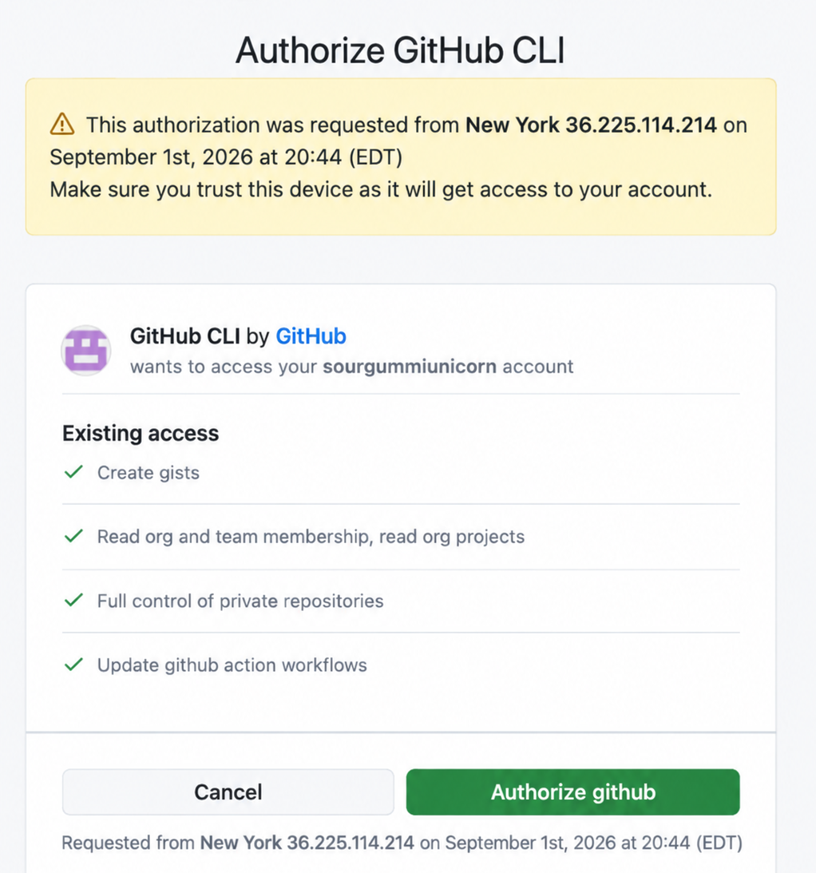
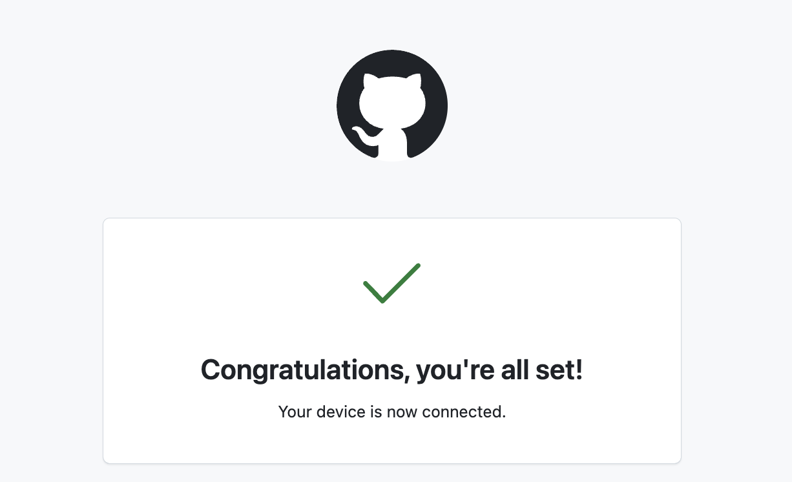


Connect Codex to Github
Example prompts:
To set up Git:
Please check whether Git is installed on my computer. If it is installed, initialize Git for this project, and show me the Git status. (Explain each step briefly before you do it.)
To connect to Github:
Please help me connect this project to my GitHub repository and push the current project to GitHub. (Briefly explain each command before you run it and ask for my approval before making changes.)

Slide 10
CODEX Do’s & Don’ts
Do’s
Don’ts
Start with a clear goal
Give context… what you're building and why
Break big tasks into smaller steps
Run and test often
Ask questions when you don't understand code
“Make something cool.”
Assume Codex knows what you have in mind
Ask for an entire complicated app at once
Assume it works because Codex says it works
Copy code you don't understand

Slide 11
Useful shortcuts+
/status | Check your current session/usage information
/model | View or change the model/settings available to you
/plan | Have Codex plan the work before making changes
/review | Ask Codex to review code/changes
/goal | Keep working toward an outcome
/clear | Start with a clean conversation
→ If you don’t see the code panels, then ask “Open index.html, main.css, app.js, so I can review the code.” or “Show me the main code files.”
→ Command + Shift + B to view the browser

Slide 12

Activity 2 - Ridiculous Future Predictions
Discuss your idea as a team.
What kind of future prediction experience do you want to create?
Write your own prompt for Codex.
Don't copy another team's prompt. Decide what details you think Codex needs.
Give your prompt to Codex and let it build.
Run the result and see what you get.
Test it.
Enter your names and try several predictions.
Iterate.
Ask Codex to make at least 2 changes based on what your team likes or doesn't like.
Make it yours.
Add at least one idea that your team came up with, not something suggested by Codex.
Share your result.
Show the class:
  Your final prediction machine
  Your original prompt
  One follow-up prompt
  Something unexpected Codex did
Created by chatgpt

Slide 13
Next Week
Watch Dr. Kuwata’s videos to set up Codex + GitHub
No assignment this week
Coming Up Next Week: Code, Ethics in Programming and AI
Wishing you a great start to the semester. Stay positive and enjoy!

